Slide 1
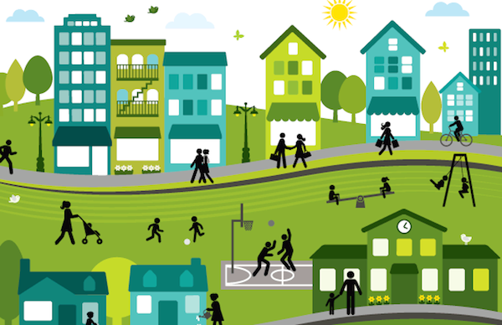
Sustainable Communities

Slide 2
What is Sustainability?
Resources
What we have
Meets the needs of the present without compromising the ability of future generations to meet their own needs.
Production
What we make
Lifestyle
How we use it

Slide 3
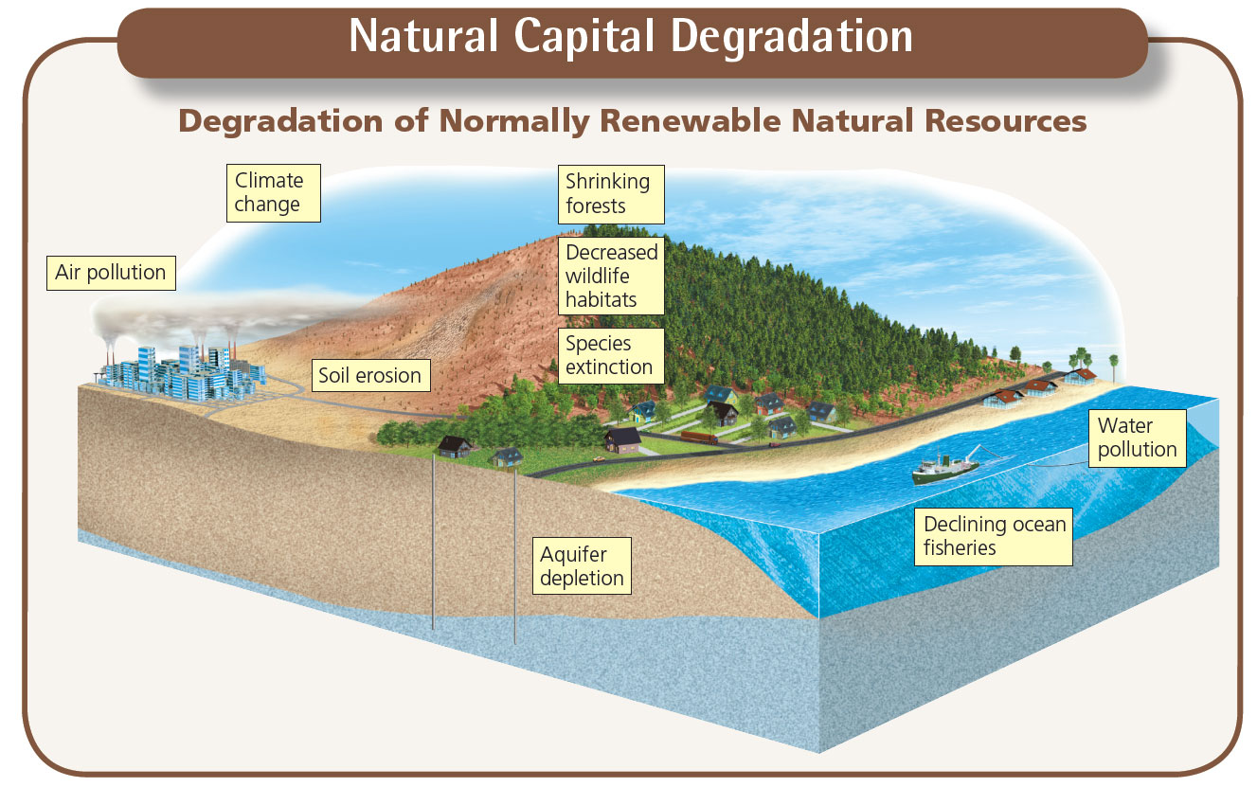

Slide 4
What is Unsustainable?
Exploitation of Natural Resources
Non-renewable energy
Deforestation
Soil erosion
Environmental Pollution
Air pollution
Water pollution
3. Waste Generation
Non-biodegradable materials
Lack of recycling and reuse

Slide 5
Sustainable Communities
Sustainable communities are planned, built, or modified to encourage unsustainable living; usually designed so inhabitants can generate minimal environmental impact.
Efficient use of energy, water, and natural resources
Minimize waste, recycle and reuse
Limit pollution
Protect and provide access to nature

Slide 6
Elements of Sustainable Communities
Efficient use of energy and water
Green building
Locally sourced food and drink
Efficient transportation systems
Recycle and reuse
Inclusion and participation

Slide 7
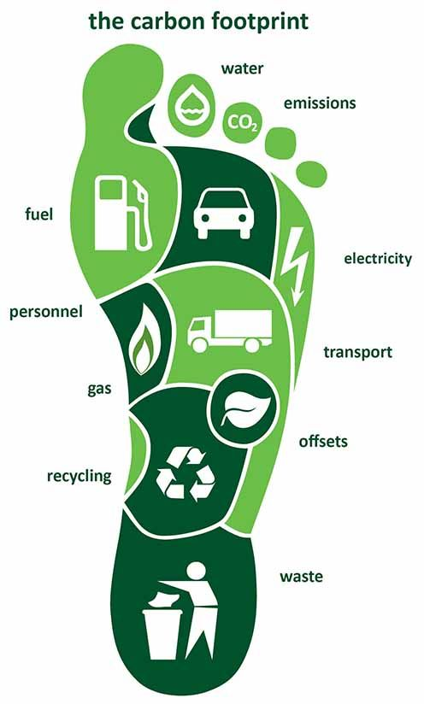
Carbon Footprint
The effects that a person, business, activity, or community has on an environment.
What’s your carbon footprint?
What about your school?
Or your Community?

Slide 8
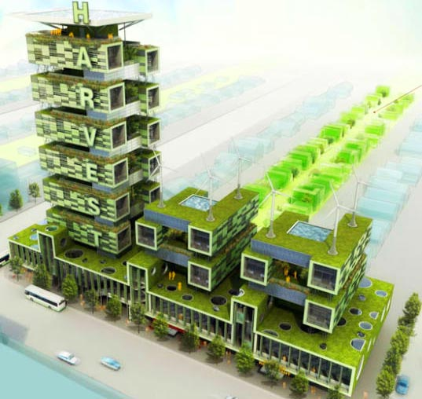
Principles of Green Design
If you were tasked with submitting a design a new sustainable building for your school, what would you want to include to reduce environmental impact?
Recycled building materials
What materials do you think your school was constructed with?
Energy efficiency
How much energy do you think the school uses each year?
Water efficiency
How much water do you think the school uses each year?
Waste reduction
How much waste do you think the school produces each year?
Green space
Do you have access to green space like parks and gardens?

Slide 9
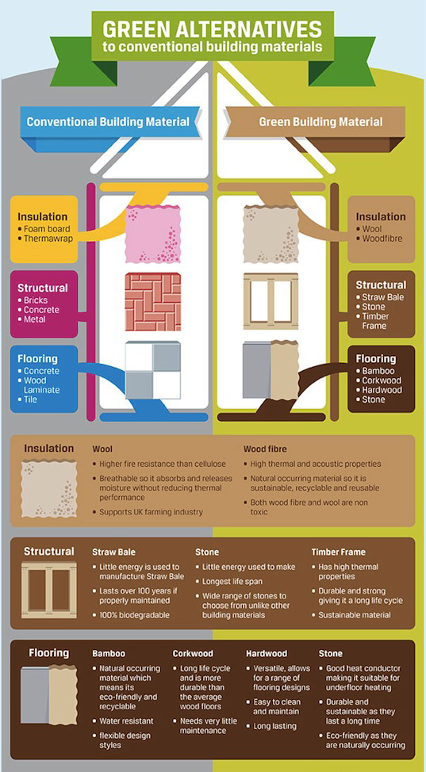
Eco-Friendly
Building Materials
1. Renewable or recycled products
2. Promote Sustainable Energy
3. Low environmental impact
Examples: recycled steel, salvaged or reclaimed wood, recycled plastic, bamboo

Slide 10
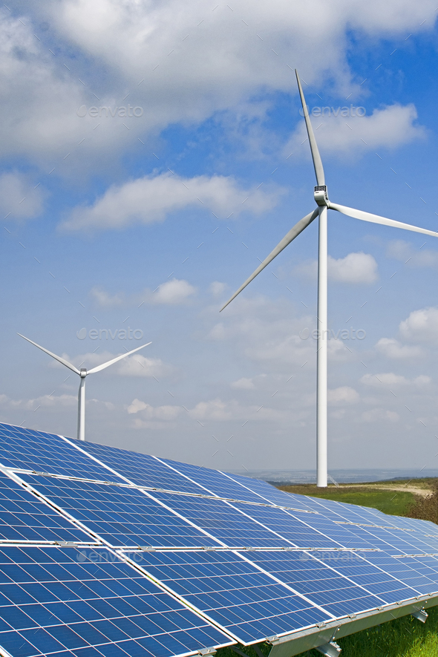
Energy
Efficiency
1. Reduce energy consumption
2. Reduce operating energy
3. Generate renewable energy
Examples: solar panels, wind turbines, high affiance appliances, insulation, double-paned windows

Slide 11
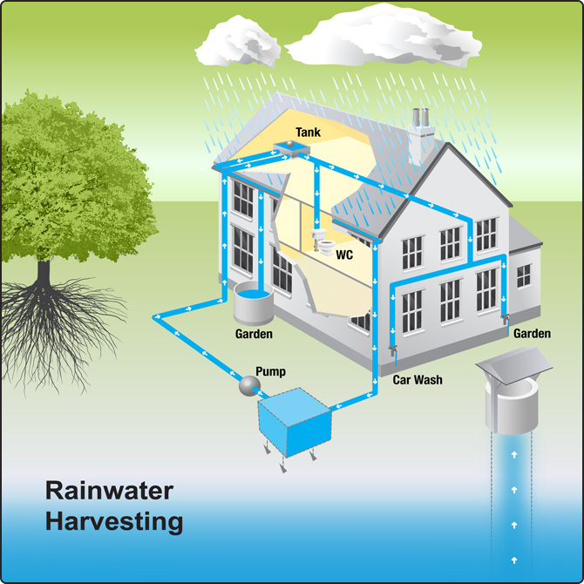
Water
Efficiency
1. Reduce water consumption
2. Protect water quality
3. Reduce runoff
Examples: water collection systems, low-flow water fixtures, water recycling systems

Slide 12
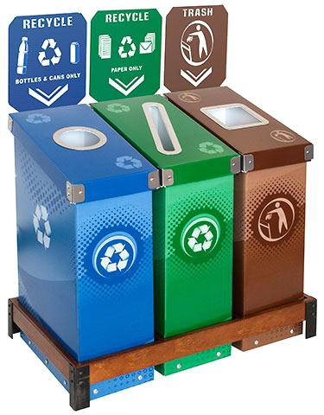
Waste
Reduction
1. Reduce materials going to landfills
2. Increase recycling
Examples: recycling bins, compost bins

Slide 13
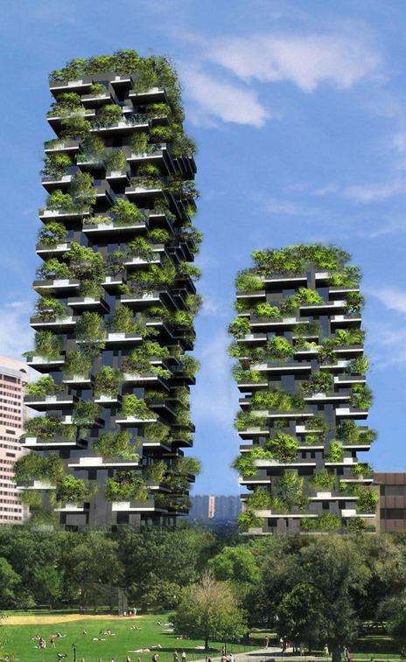
Green Space
1. Improve air and water quality
2. Provide shade and lower temperatures
3. Reduce soil erosion and retain rainwater
Examples: green roofs, gardens, parks, courtyards

Slide 14
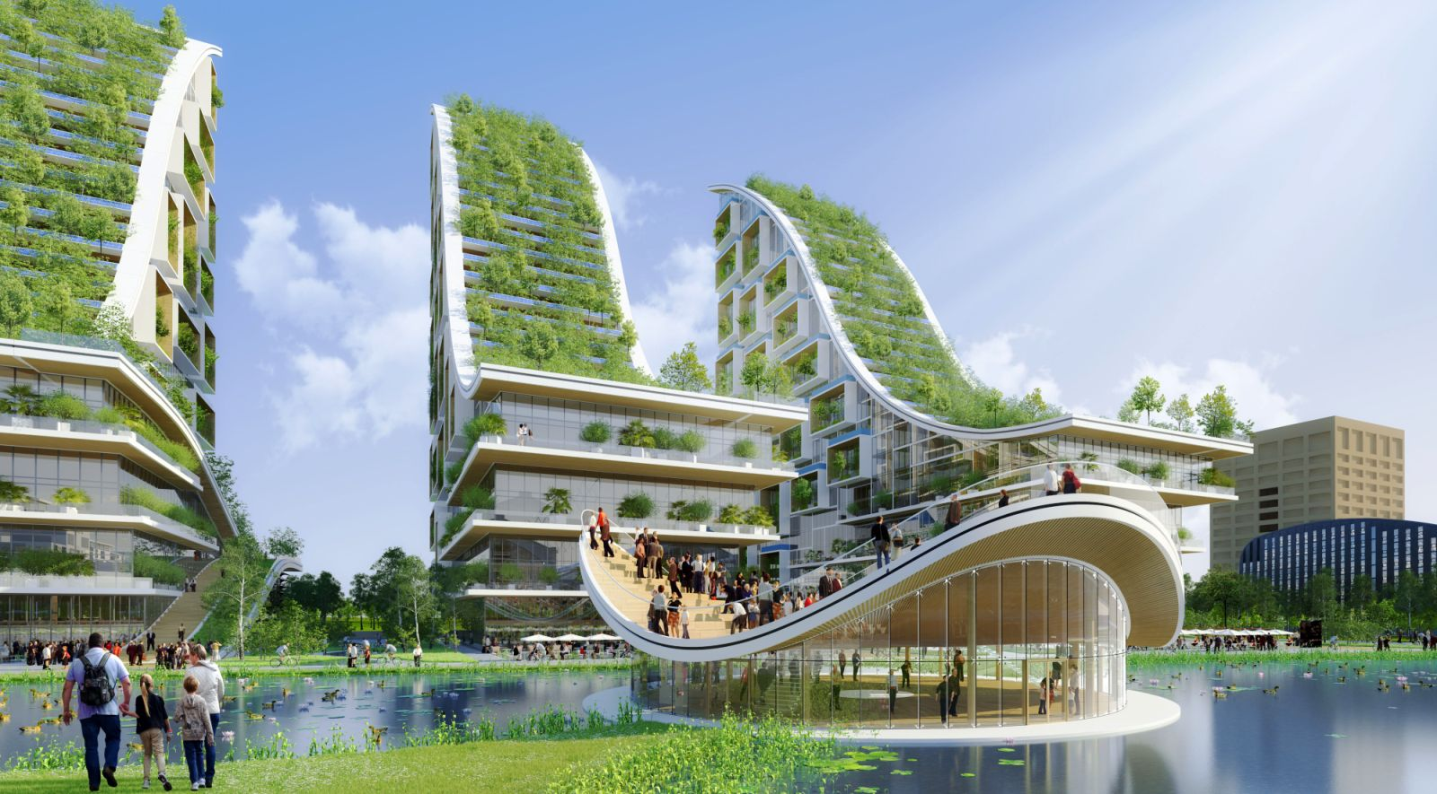
Create your own eco-friendly design!

